Slide 1
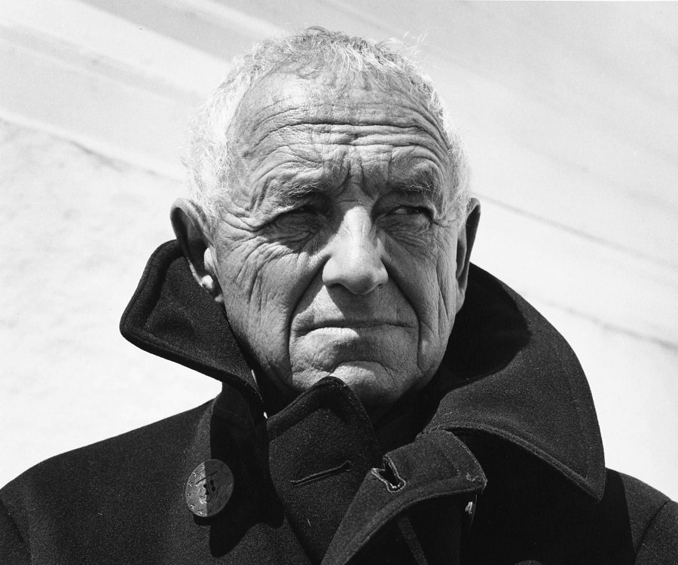
Andrew Wyeth
American Painter – Watercolor and Tempera
realism in portraiture and pastorals
Pastorals-a work of literature portraying an idealized version of country life
Chadds Ford
1917-2009

Slide 2
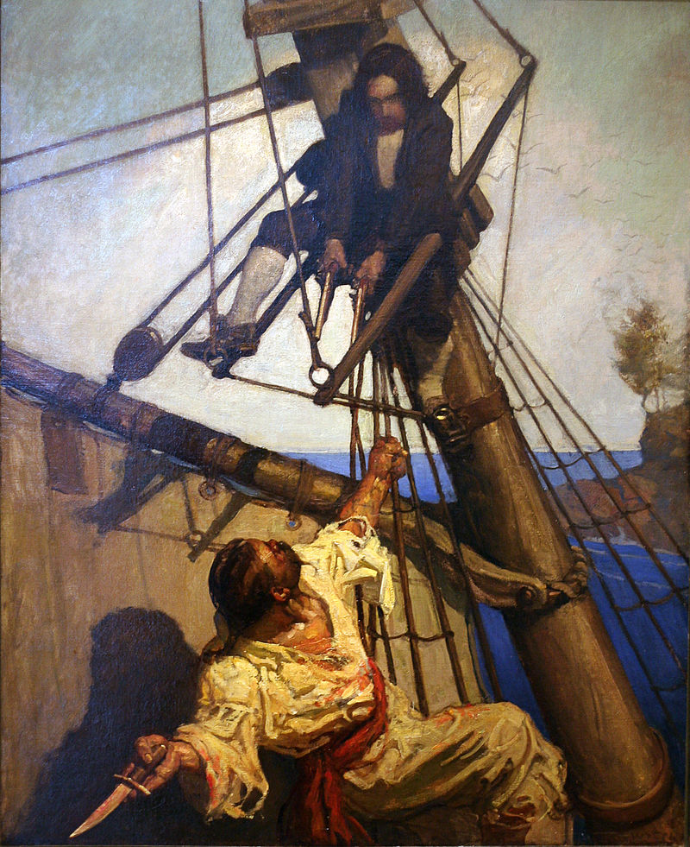
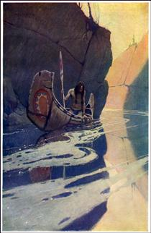
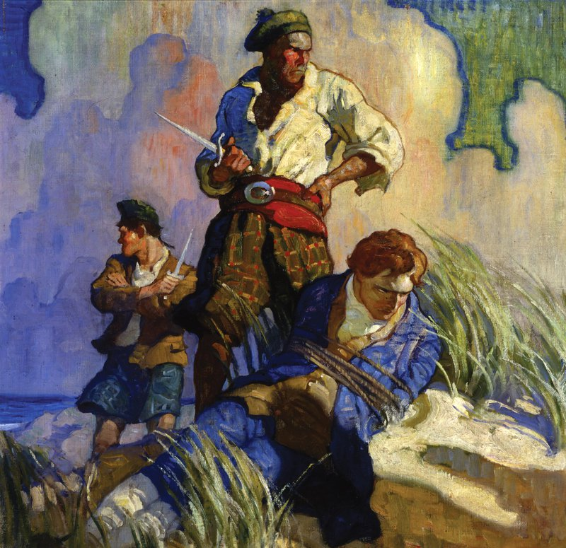
Important Facts
Son of N.C. Wyeth – illustrator 1882-1945
Treasure Island

Slide 3
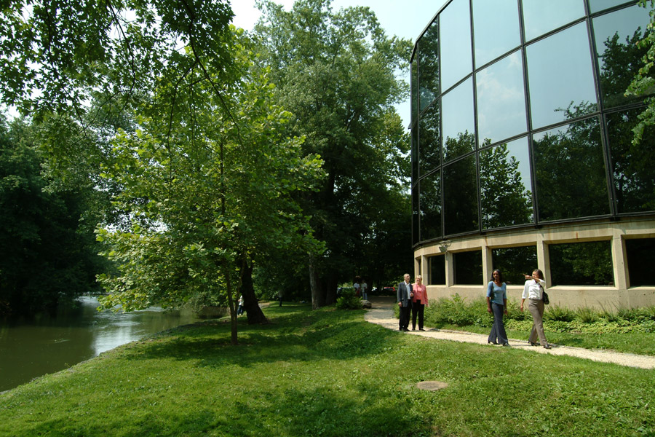
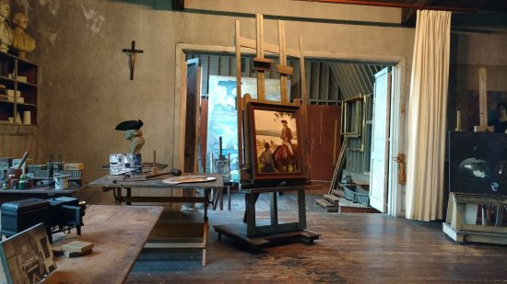
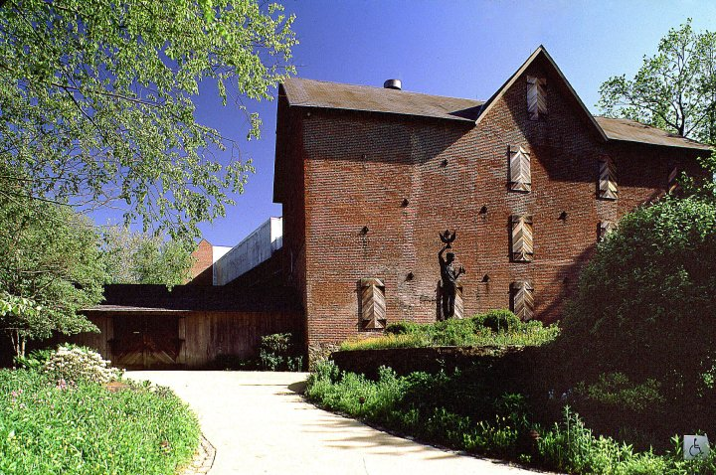
Grew up in the Chadds Ford Area
Brandywine River Museum

Slide 4
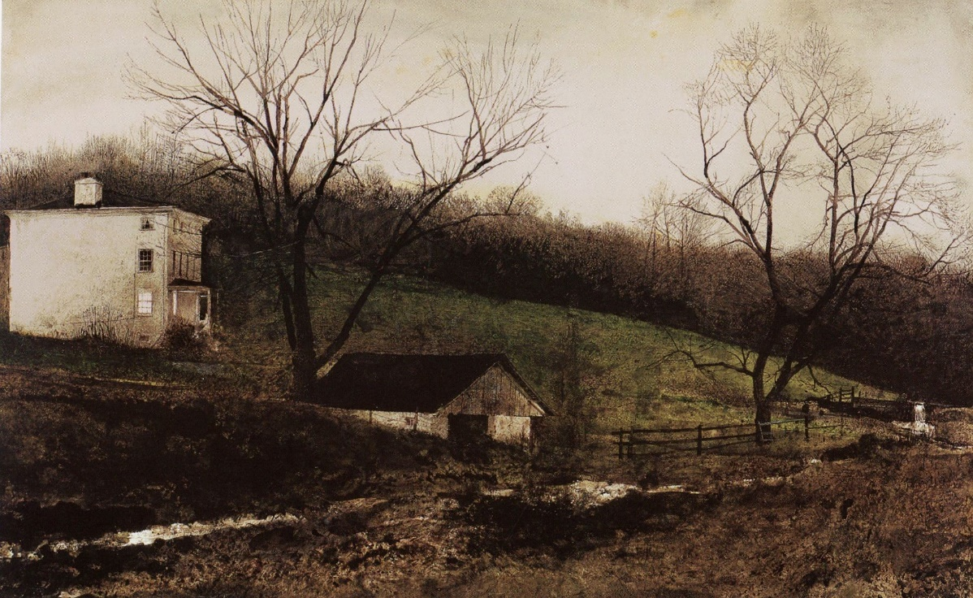
Kuerner Farm

Slide 5
What is tempera?
also known as egg tempera, is a permanent, fast-drying painting medium consisting of colored pigments mixed with a water-soluble binder medium (usually a glutinous material such as egg yolk or some other size)
Very long lasting
Primary paint until 1500’s
Tempera – Encaustic – Oil
applied in thin, semi-opaque or transparent layers
Egg tempera is not a flexible paint and requires stiff boards; painting on canvas will cause cracks to form and chips of paint to fall off.
Must add something to the egg and pigment or there will be cracking since it dries so quickly. (distilled water, vinegar etc.)

Slide 6
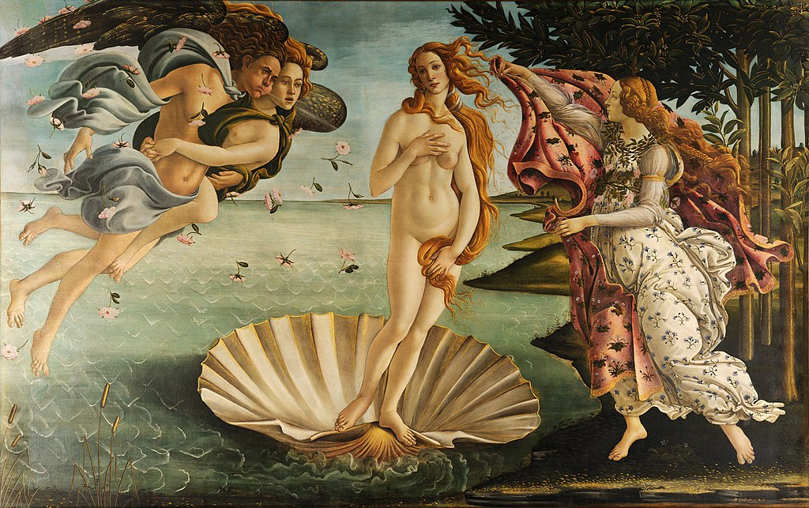
The Birth of Venus Sandro Botticelli 1486 Raphael

Slide 7
Wyeth Paintings – 1st Tempera Painting

Slide 8
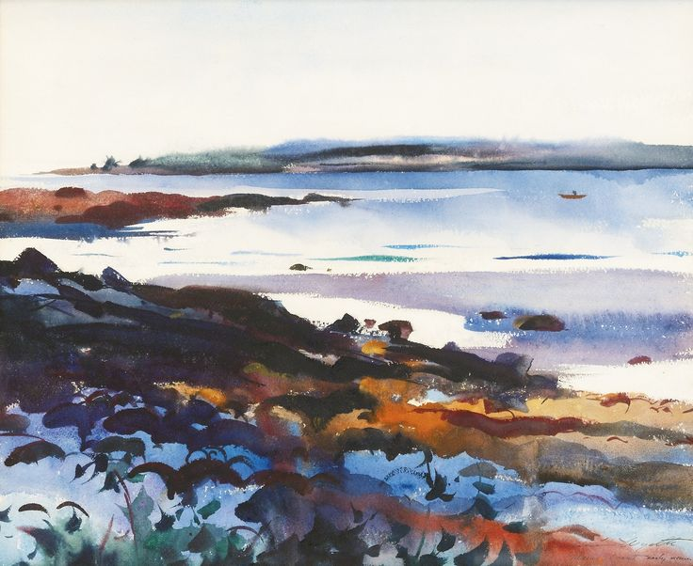
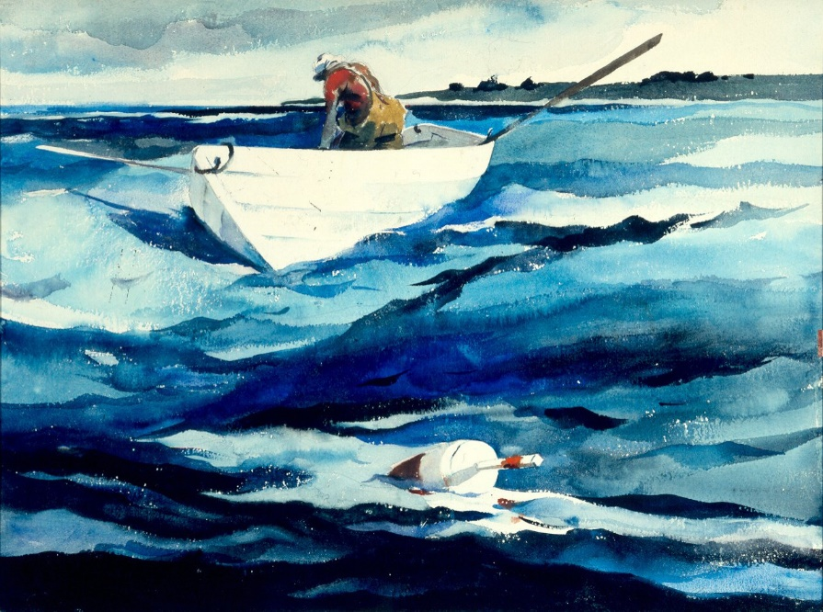
Early Watercolors – loose and abstract

Slide 9
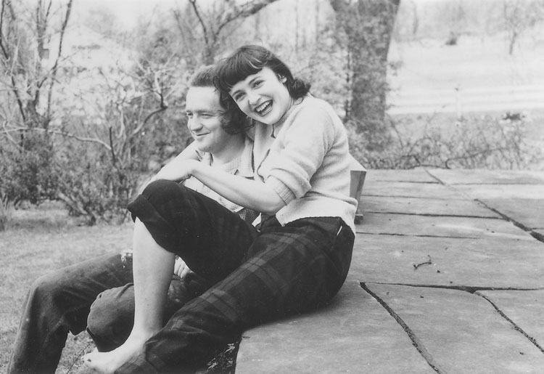
Married Betsey James
Betsey titled all of Andrew’s paintings
Had 2 sons

Slide 10
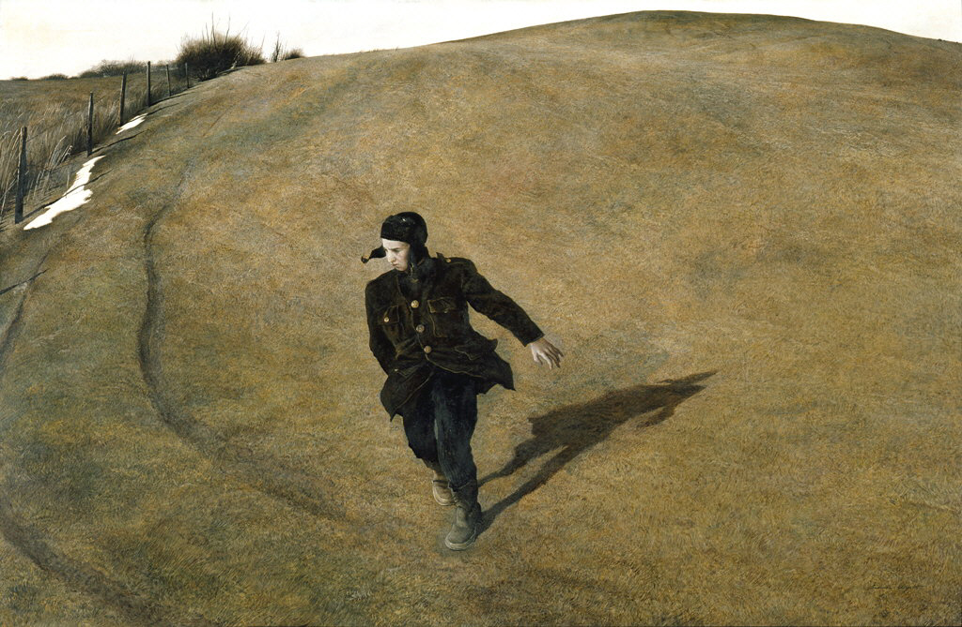
1945 – N.C. Wyeth is killed in a car crash
This changes A. Wyeth’s paintings dramatically

Slide 11
“My father’s death put me in touch with something beyond me, things to think and feel, things that meant everything to me.”

Slide 12
Christina

Slide 14
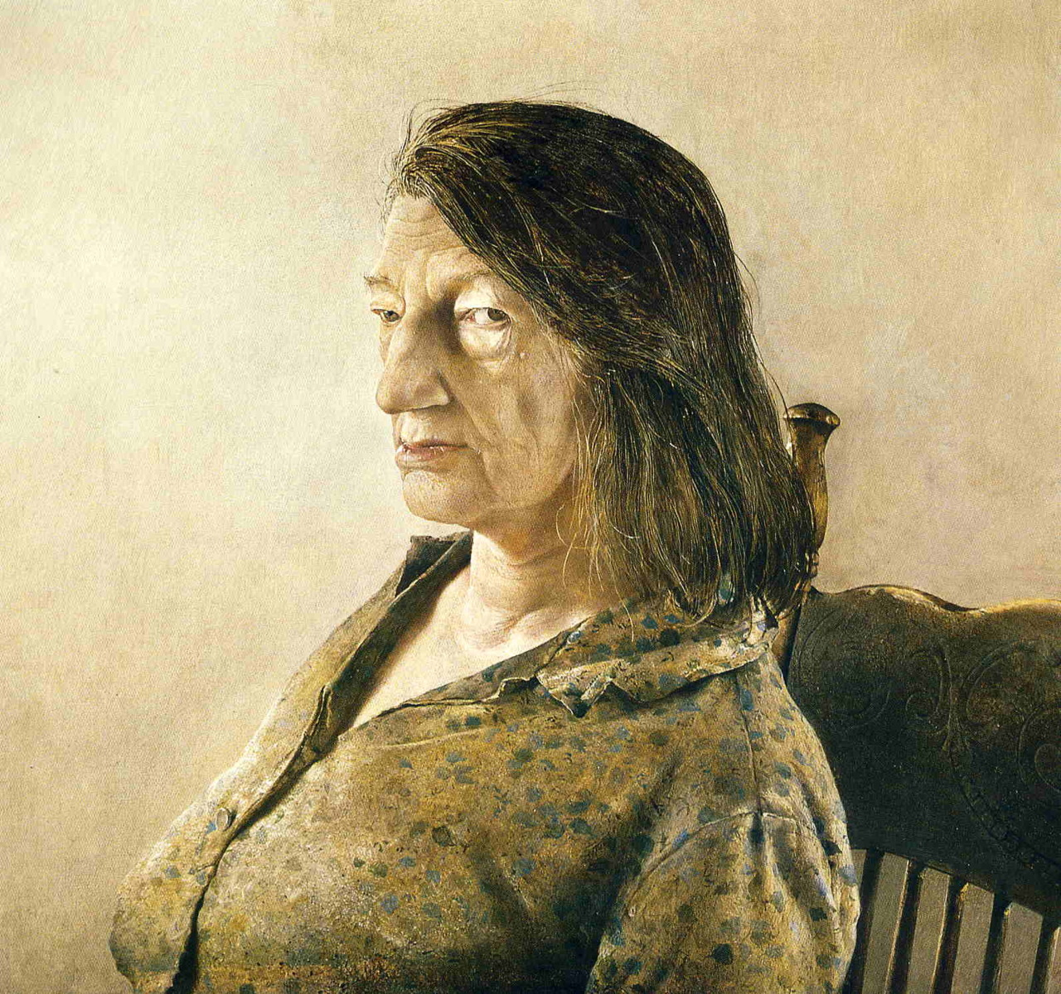

Slide 15
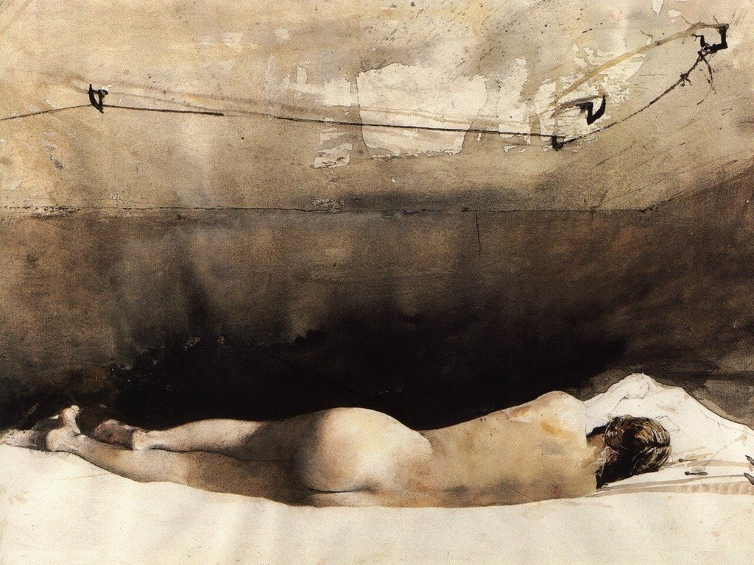
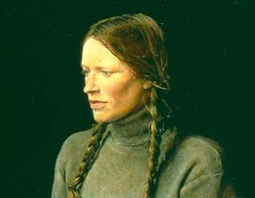
Helga

Slide 16
Andrew Wyeth – Looking Out, Looking In

Slide 19
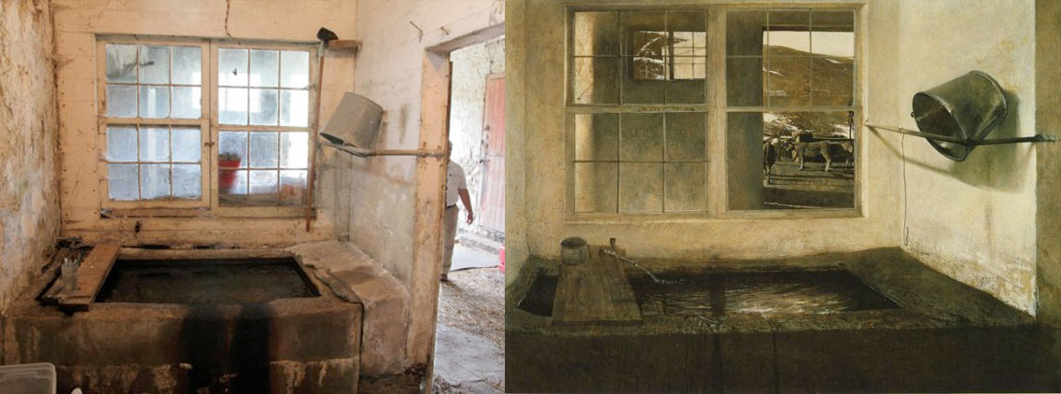

Slide 20
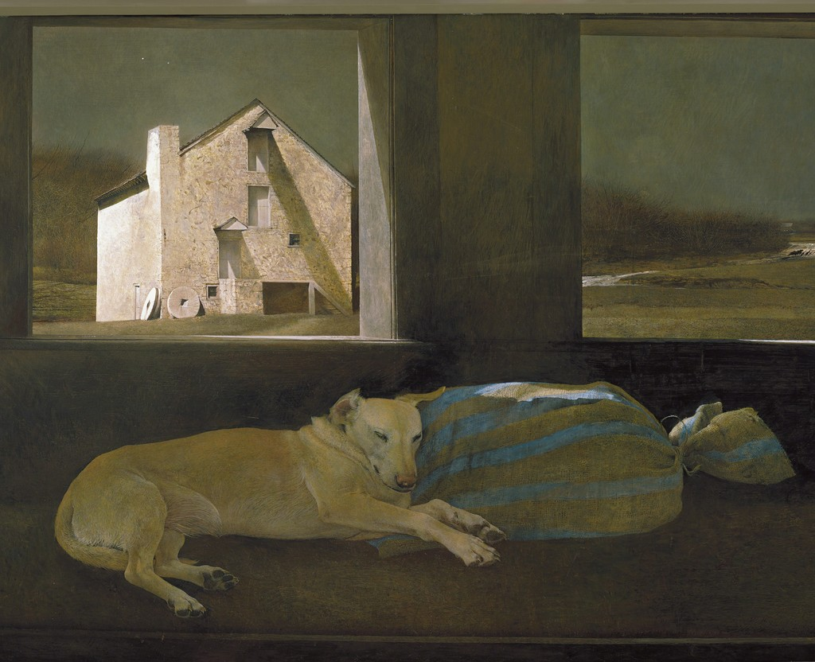

Slide 21
